Slide 1
Data Science with Python
muksurat choudhury

Slide 2
Linear Regression
Perform Linear Regression on ”Flight Take Off Data" dataset
Import libraries
Load dataset
Review and sort data
Exploratory Data Analysis
Linear Regression:
Assign X and Y
Make predictions using Linear Regression
Create DataFrame for predictions
Model Evaluations
Submit a link to your notebook

Slide 3
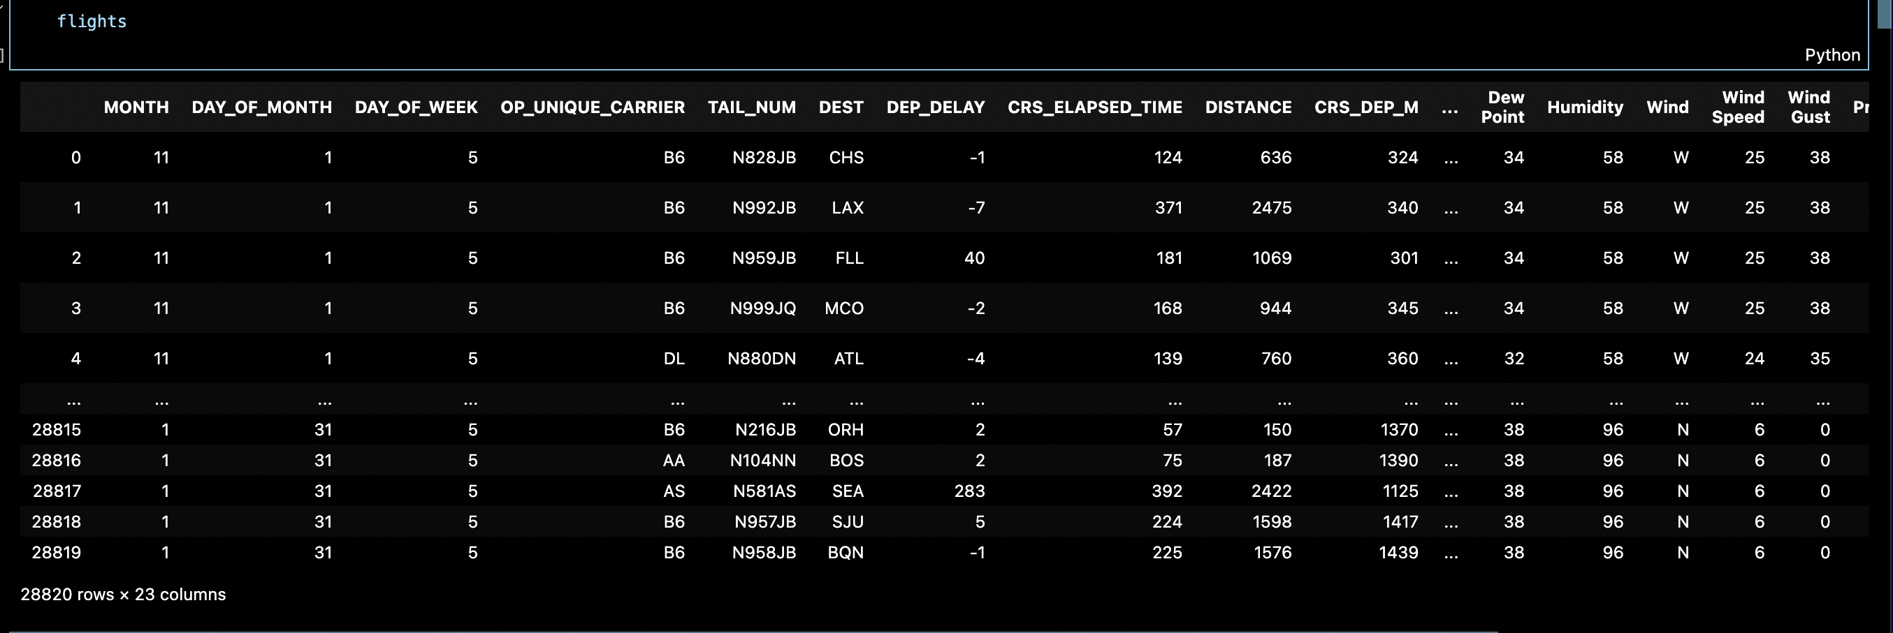
The Data
import numpy as np
import pandas as pd
import matplotlib.pyplot as plt
import seaborn as sns
from sklearn.model_selection import train_test_split
from sklearn.linear_model import LinearRegression
from sklearn import metrics
Notes:
I began with importing libraries I would be using: numpy, matplotlib, pandas, seaborn, sklearn withtrain, test, split, linear regression and metrics
I viewed the information within the data here to see there are over 28000 rows and 23 columns

Slide 4
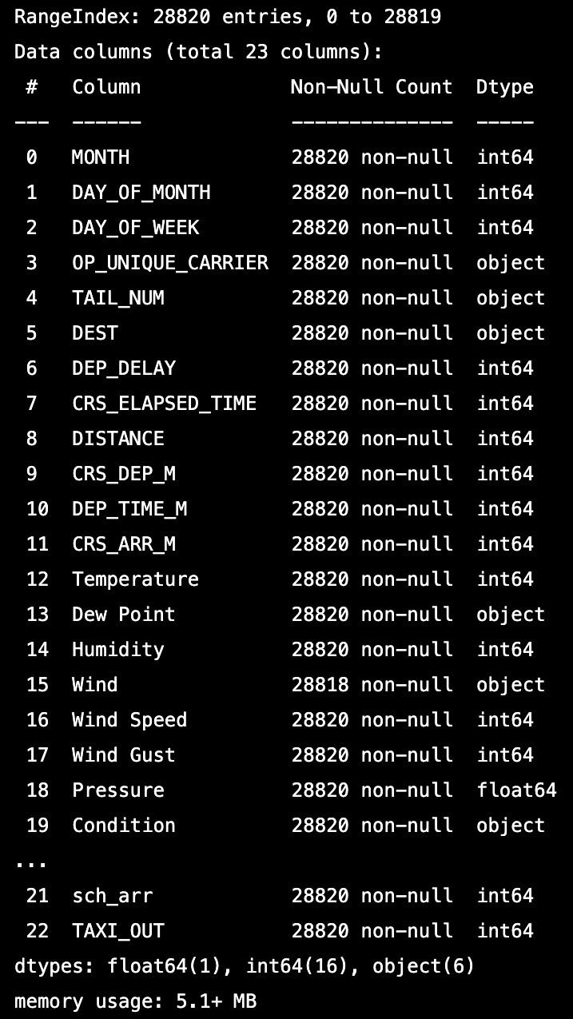
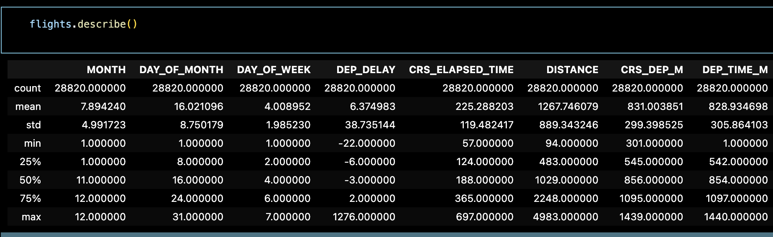
Review The Data
flights.info()
flights.describe()
Notes:
I used info and describe to review the data more closely, I noted that the data types are a mix of integers, objects and floats, I would need to change this to integers only to perform regression
So I tried to understand the data and what might be relevant or not for analysis so I can sort it and convert it to integers

Slide 5
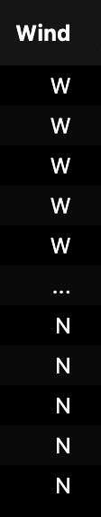
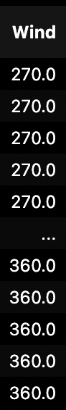
Sort The Data
Notes:
To sort the data, I first looked at the Wind column and changed all the wind directions to their respective measure of degrees
Replacing North with 360, East with 90, South with 180, West with 270 degrees and so on

Slide 6
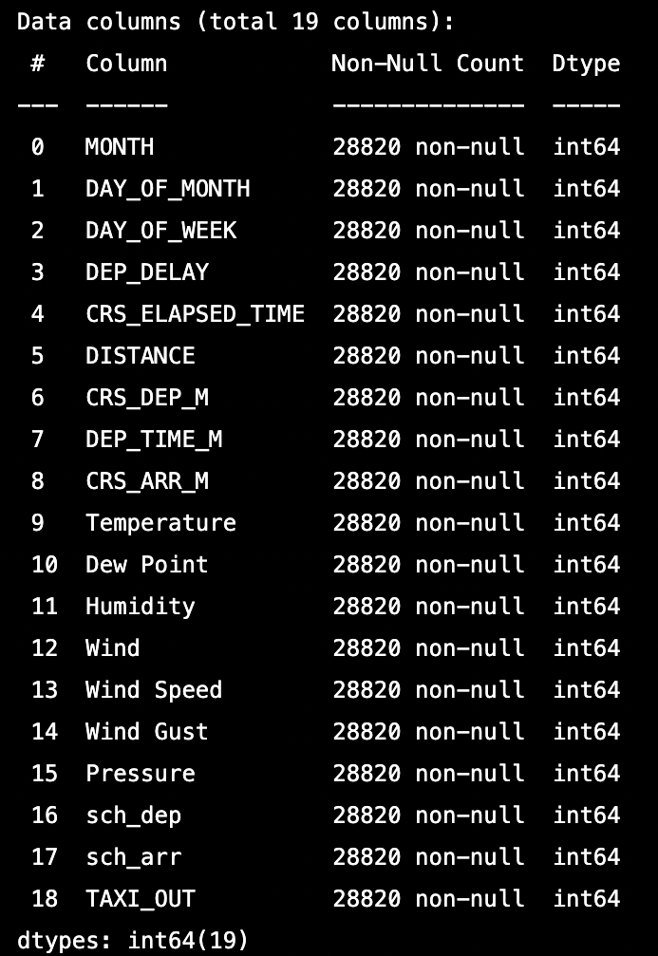
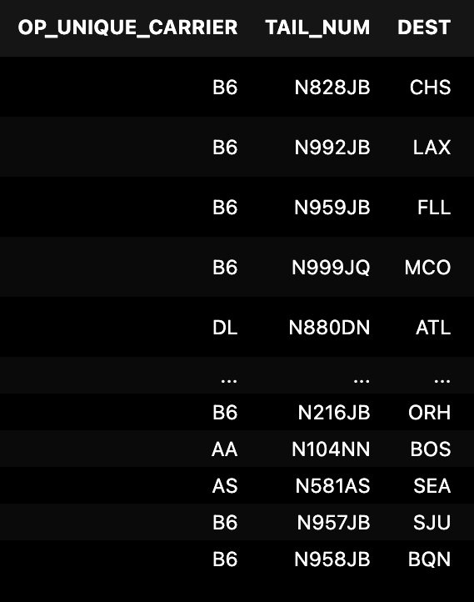
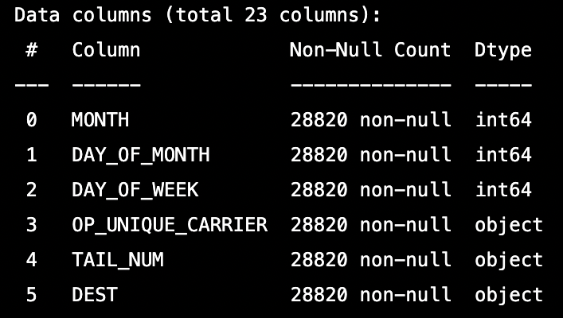
Sort The Data
Notes:
I also dropped some of the columns that were data types of objects
For example I don’t need the Unique Carrier codes as its not relevant to the data analysis I’m about to do
After that I had 19 columns remaining and just to be sure, I changed the data type to integer as you can see here on the right

Slide 7
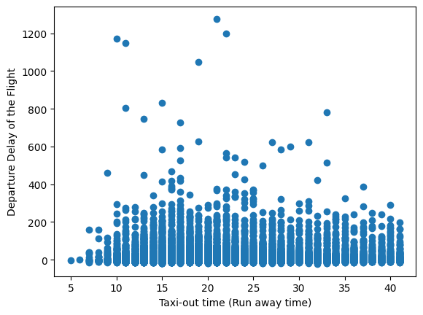
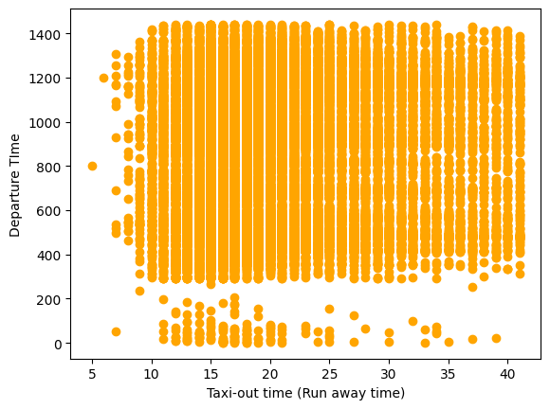
Exploratory Data Analysis
Notes:
These are some scatter plots to show a few of the columns against Taxi Out
On the left, you can see that there’s no correlation to the departure delay of the flight with the taxi out time
And on the right, you can see that there’s no correlation to the actual departure time and taxi out time

Slide 8
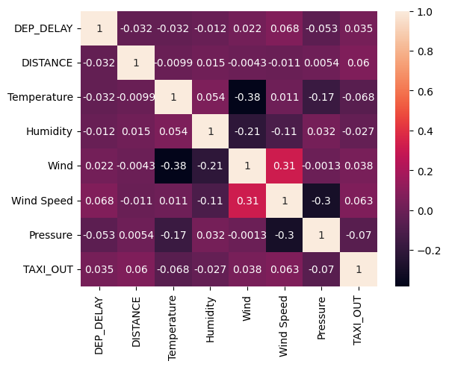
Exploratory Data Analysis
Notes:
I made this heatmap using some of the columns to get a view overall, but again none of the features showed strong correlation with taxi out time
The strongest correlation we can see here is wind with wind speed at 0.31, but that is also not very strong correlation

Slide 9
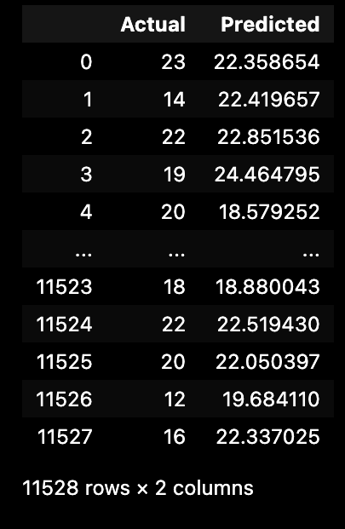
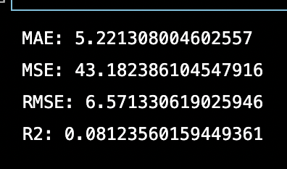
Linear Regression
60% TRAINING 40% TESTING
Model Evaluation
Week 5: Assignment 7
Notes:
I assigned X values to be all the columns except for Taxi Out and assigned Y as Taxi Out
Then I trained, tested and split the data with 60% training and 40% testing and created this dataframe of Actual and Predicted values
You can see some of the predicted values are far from the actual, for example 14 actual and 22 predicted or 19 actual and 24 predicted
I did some model evaluation anyway to see the accuracy, but the R squared was only 8% which tells us why our data may not have any correlation in the heatmap and scatter plots we looked at earlier
I tried it again with 80% training and 20% testing but the result was the same, the R squared remained the same at 8%

Slide 10
Thank you!

